Slide 1

AI Skill Gap Analyzer
Milestone -2
Priya Poosaala
priyapoosaala@gmail.com
.

Slide 2

Project milestone Overview
The AI Skill Gap Analyzer is a web-based system that automates the extraction, analysis, and visualization of both technical and soft skills from resumes and job descriptions.
It uses advanced Natural Language Processing (NLP) and Machine Learning (ML) models like spaCy pipelines, custom NER, and Sentence-BERT embeddings.
It helps recruiters and learners identify skill gaps, analyze skill trends, and support data-driven hiring and training decisions through an interactive Streamlit interface.
=

Slide 3
Project Objectives
Automate skill extraction from resumes or job descriptions.
Use multiple extraction techniques: POS, context-based, NER, and noun chunking.
Perform semantic skill similarity using BERT embeddings.
Allow users to train custom NER models.
Provide interactive skill visualizations (Pie, Bar, Radar, Treemap, Sunburst).
Export reports in CSV, JSON, or text.
Offer a real-time interactive Streamlit UI.

Slide 4
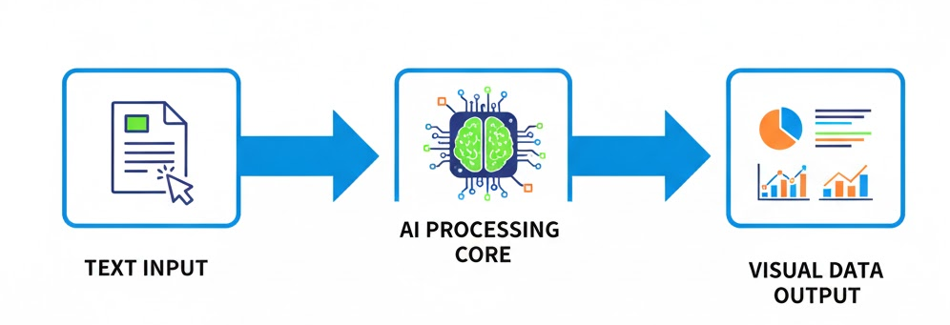
Project Architecture Overview
Flow:
Input (Text/PDF) → Layer 1: Robust Extraction → Layer 2: Semantic Analysis (BERT) → Output: Data & Visuals.

Slide 5

Workflow in Action
The web app guides users through a structured workflow:
Skill Extraction: Detects skills using multiple linguistic and contextual methods.
Skill Embedding: Generates BERT-based vectors for skill similarity.
Custom NER Training: Users can annotate and train personalized NER models.
Annotation Module: Build and export labeled data for training.
Visualization Dashboard: Explore insights with charts and tables.
Result Export: Download structured reports in various formats.

Slide 6

Behind the Architecture
The project is structured into modular components:
• SkillDatabase – Manages categories and patterns.
• TextPreprocessor – Cleans and tokenizes data.
• SkillExtractor – Detects and scores skills.
• SentenceBERTEmbedder – Computes semantic similarity.
• CustomNERTrainer – Trains and tests skill models.
• AnnotationInterface – Handles annotation workflows.
• SkillVisualizer – Generates interactive graphs.
• Main Streamlit App – Controls navigation and state.

Slide 7
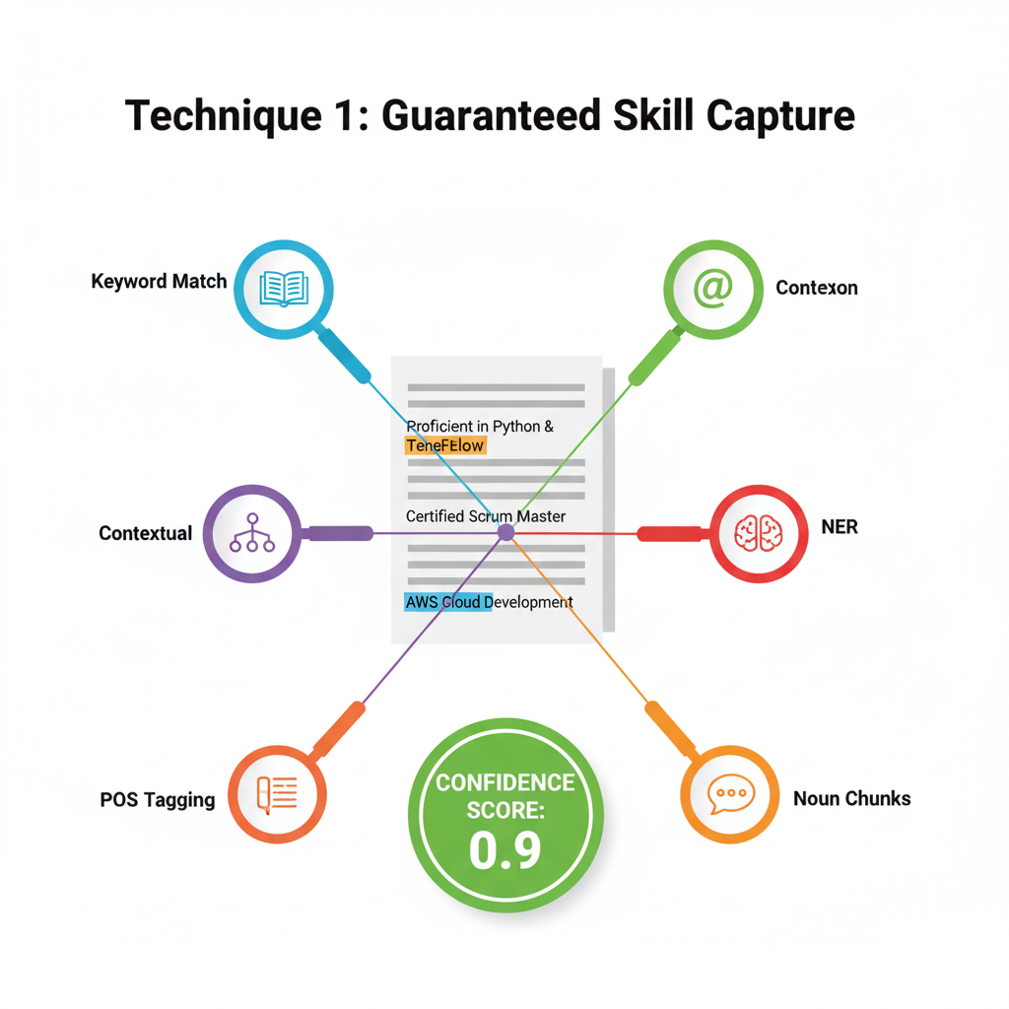
Semantic Analysis with BERT 💡
Challenge: Rule-based systems cannot grasp the relationship between "Keras" (a framework) and "Deep Learning" (a concept).
Solution: Sentence-BERT: We map every skill to a high-dimensional vector space.
Mechanism: SBERT ensures that skills with similar meanings, like Kubernetes and K8s, are placed close together. This allows us to search for related concepts, not just exact words. Visual: A visual representation of vector embeddings or a graphic of two related words connected by a high similarity score.

Slide 8
Practical BERT Features
Demonstrating Semantic Relationships
Skill Similarity Comparator: The user can pick any two skills from the extracted list and get their Cosine Similarity score instantly (e.g., "PostgreSQL" vs. "MongoDB" = 0.65).
"Find Similar Skills": Used for cross-reference, suggesting skills (e.g., if a resume mentions Python, the tool can suggest related skills like NumPy or Pandas).
Skill Matrix Heatmap: We generate a matrix showing how strongly every top skill is semantically related to every other skill in the profile. Visual: A screenshot or output of the Similarity Heatmap from the app.

Slide 9

The App Interface (Streamlit) 🖥️
The Interactive Dashboard Experience
The entire project is packaged in a user-friendly Streamlit web app.
Input Handling: Supports Text Pasting and File Upload
Navigation: The use of tabs cleanly separates the workflow: Extraction, BERT Embeddings, Training, and Visualizations. Visual: A full-page screenshot of the main "Extract Skills" tab.

Slide 10

Analysis
SkillVisualizer
Purpose: Visualize results
Charts Used:
✅ Pie Chart
Radar Chart
Treemap
Library: The Python library used for generating the diagrams (charts and graphs) in your Streamlit application code is Plotly plotly.graph_objects

Slide 11
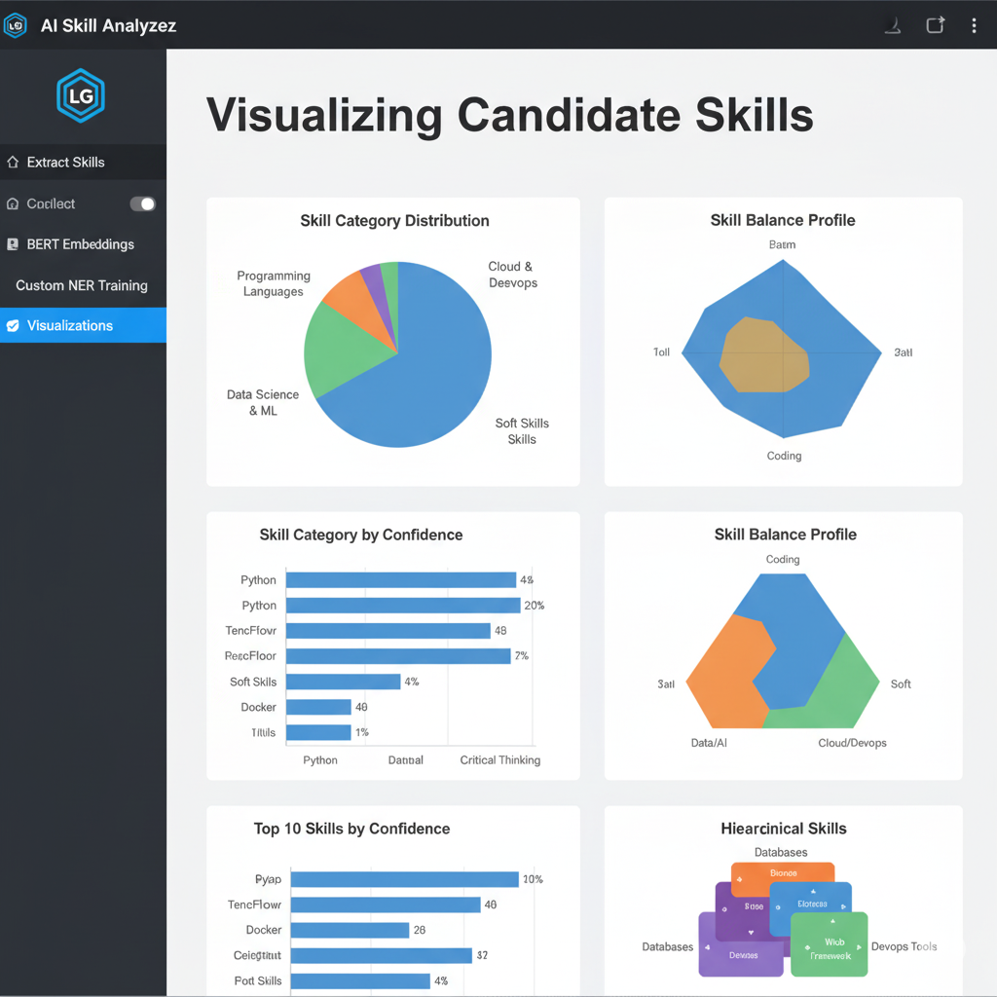
Horizontal Bar Chart of Top N Skills by Confidence Score.
Visualization
Visualization: Pie Chart showing the percentage breakdown of all extracted skills by major categories (Languages, Databases, Cloud, etc.).
Radar Chart used to assess the high-level balance across strategic domains.
Treemap organized hierarchically.
Horizontal Bar Chart of Top N Skills by Confidence Score.

Slide 12
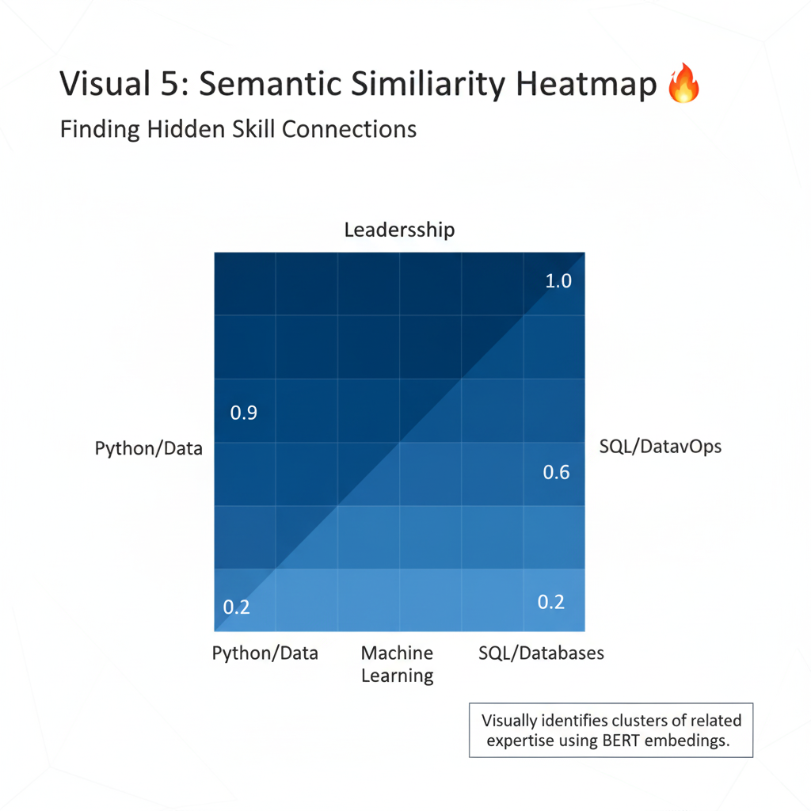
Similarity Matrix Heatmap
Finding Hidden Skill Connections
Visualization: A Heatmap showing how closely related the top N skills are to each other.
Data Source: This uses the BERT vectors.
Insight: Highlights clusters of expertise. For example, dark squares show strong ties between "Machine Learning" and "Python," validating the profile's core domain

Slide 13
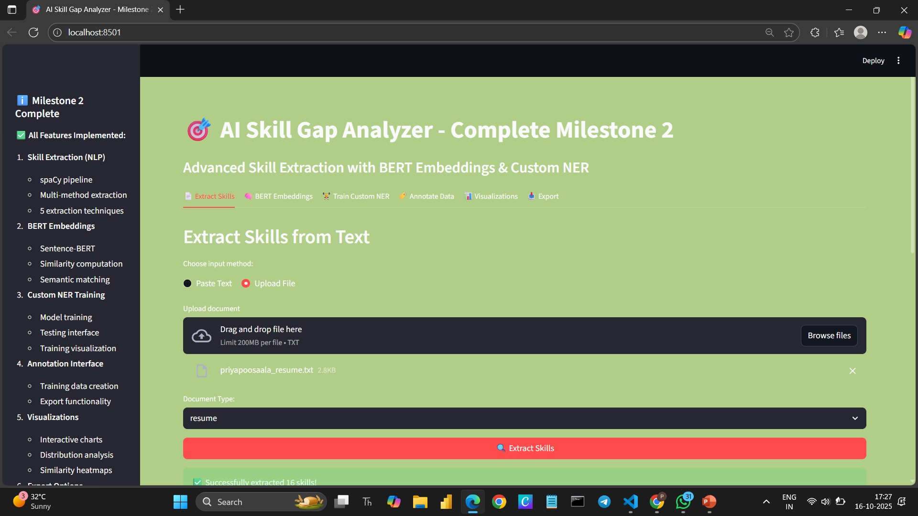
Milestone 2 snapshots

Slide 14
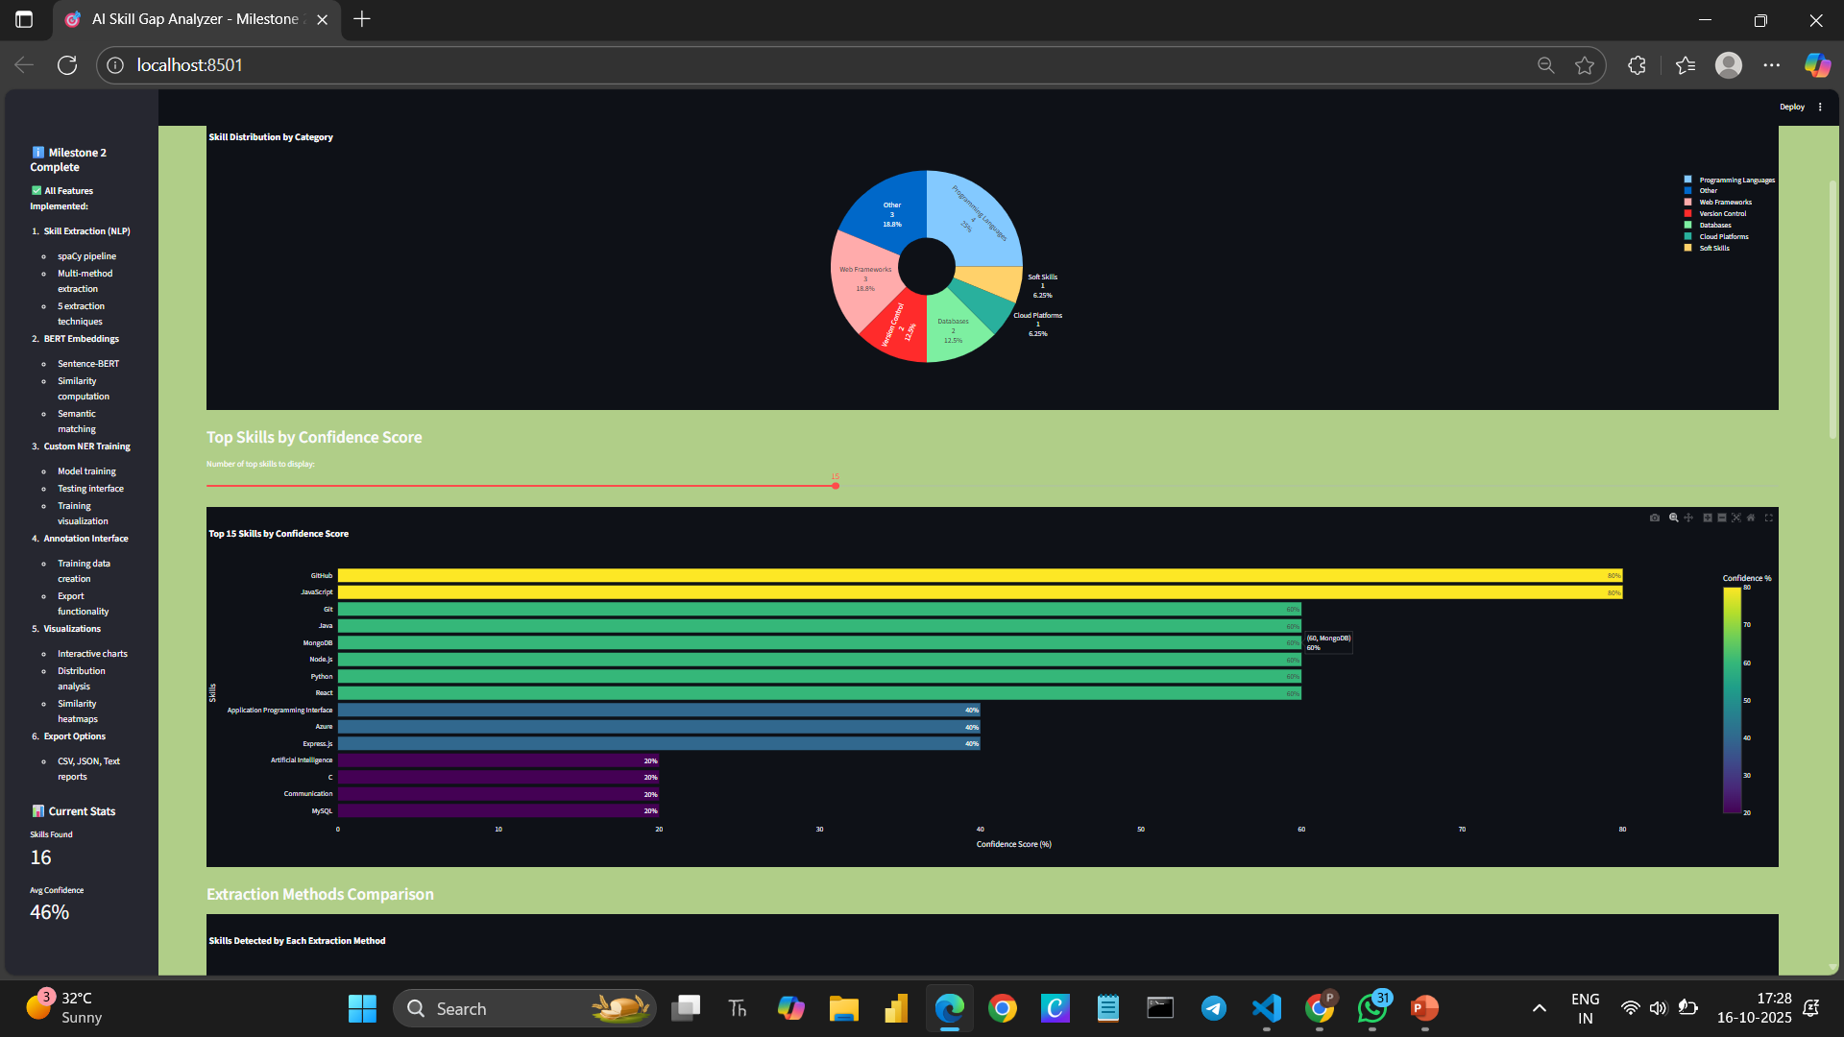

Slide 15
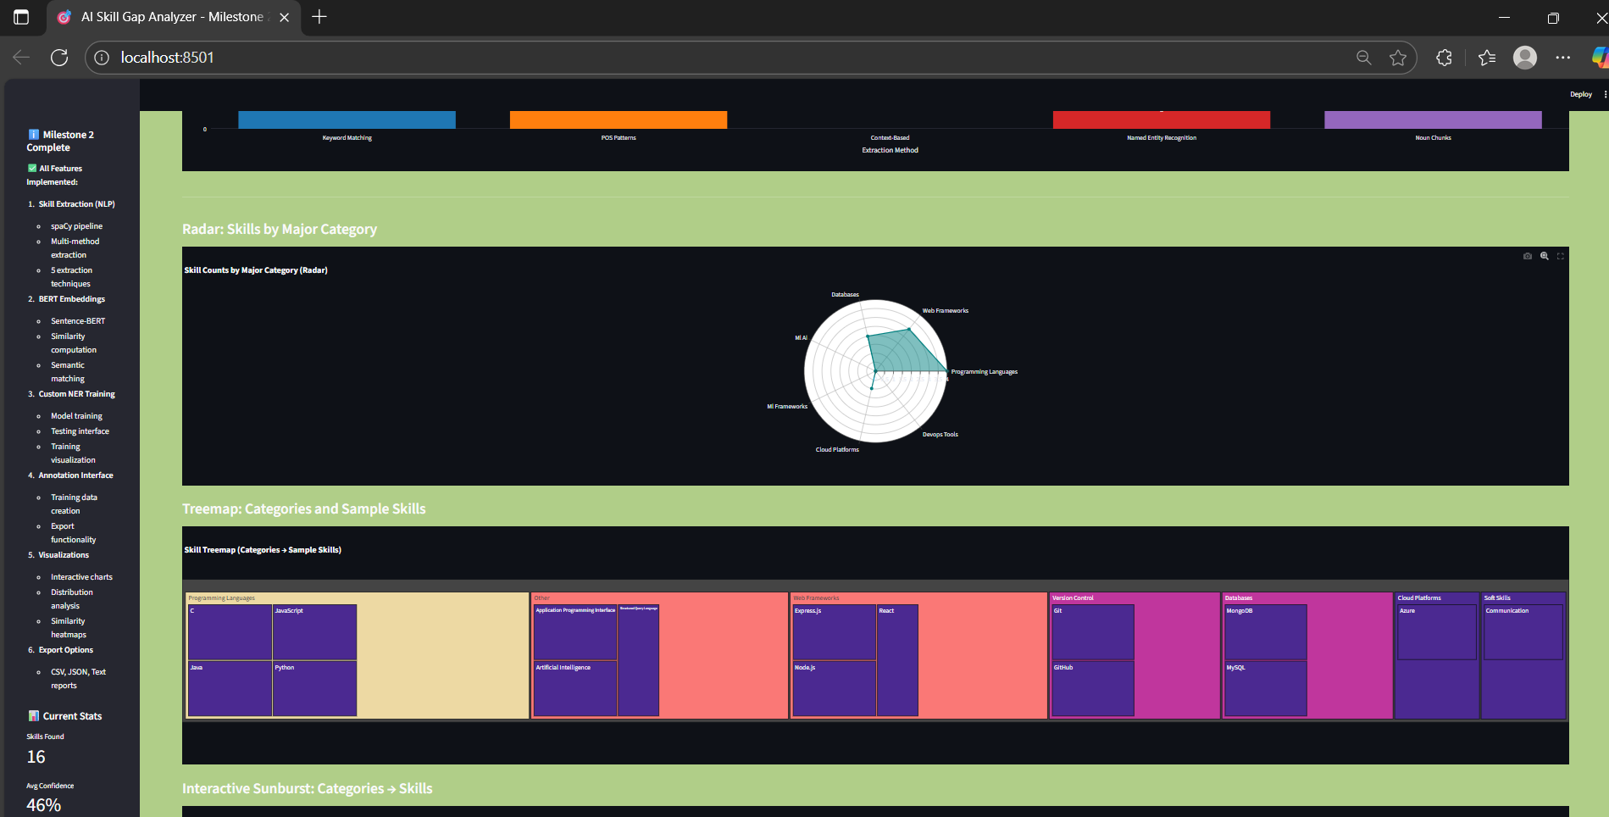

Slide 16

Future Scope and Improvements 💡
Synonym and Context Expansion: Improve skill detection accuracy using advanced semantic networks. • AI-driven Recommendations: Suggest learning paths or job roles based on detected skill gaps. • Dashboard Personalization: Allow users to customize analytics and visualization preferences.
Conclusion
The AI Skill Gap Analyzer (Milestone 2) successfully demonstrates the integration of Natural Language Processing, Machine Learning, and semantic similarity models for intelligent skill extraction and analysis. This version establishes a strong foundation for building data-driven recruitment tools, personalized learning systems, and workforce planning solutions. The project’s modular design, interactive visualizations, and customizable features ensure that it is not only functional today but also future-ready for enhancements and real-world deployment.

Slide 17

Thank You
Priya Poosaala

